Slide 1
CRITICAL THINKING IN PARENTING
Name
Importance of Critical thinking in parenting
Critical thinking at home establishes guidelines for parents to follow in developing their children.
Critical thinking provides simple guidelines to the parents on instructing their children based on the available resources.
Critical thinking allows parents to identify ways of spending time with their children and establishing relationships making it an important aspect in parenting.

Slide 2

Characteristics of a good critical thinker
Observation- observation includes careful consideration of the situation to understand every aspect of the problems an individual has to be curious to make observations. An effective critical thinker is always curious about their surroundings and different topics of interest around them. High level of awareness is also associated with curiosity. A high level of awareness allows a critical thinker to identify situations favorable for critical thinking.

Slide 3
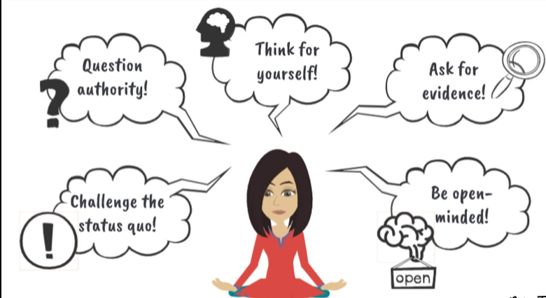
Characteristics of a good critical thinker 2
Decisiveness- a critical thinker is able to make quick decisions and take action based on those decisions. They are also to identify the best decisions out of all the available ones (Cottrell, 2017)
Challenging status quo- critical thinkers tend to think for themselves before following any rules or traditions they don’t understand, blindly.
Questioning authority- an effective critical thinker has the ability to question the ideas and concepts established by others without blindly following them.
Open-mindedness- Critical thinkers can listen to ideas from different individuals without biases.

Slide 4
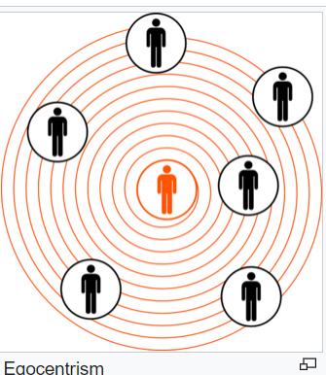
Barriers and Resistances of Good critical Thinking
Egocentric thinking- it includes the tendency to think that everything that happens is related to oneself (Cottrell, 2017). Egocentric thinking usually develops in children at the adolescent stage. Children at this stage may have a constrained point of view which may lead to arguing with different people including their parents. Parents can use their understanding of this concept to interact effectively with their children and improve their critical thinking (Monteiro, Sherbino, Sibbald, & Norman, 2020).

Slide 5

Barriers and Resistances of Good critical Thinking
Biased experiences
Biased experiences by an individual prevent their ability to be open minded and think critically. Individuals used to base their arguments on personal experiences which prevents them from being fair or using reasoning and common sense (Monteiro, Sherbino, Sibbald, & Norman, 2020). Parents need to avoid biases when making decisions relating to their children. Bias in reasoning can lead to the parents drawing false conclusions about their children which may worsen their relationships.

Slide 6
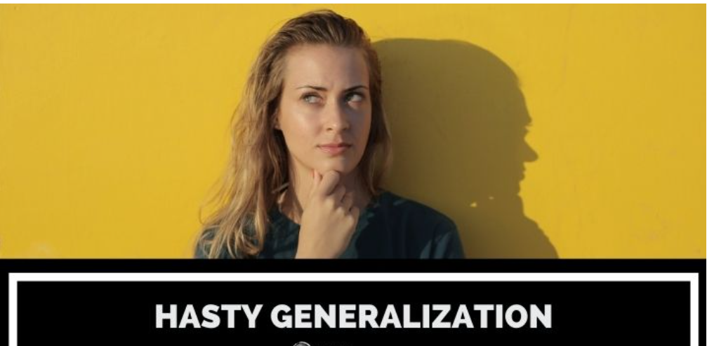
Informal Fallacies
Hasty generalizations-
Hasty generalizations includes rushing to make conclusions based on little available evidence. Drawing conclusions without enough evidence is among the factors which may hinder critical thinking (Muniz, 2018). Parents may rush to make conclusions about their teenage children based on what they have heard about other teenagers. If teenagers were caught staying out late to smoke marijuana, a parent may conclude that their child also smokes marijuana when they stay out late. This parent is unable to reason or use common sense in these situations.

Slide 7

Media and Advertising Connections
Nickelodeon Worldwide day of Play
Link: https://www.youtube.com/watch?v=sSvC3BAryn0&t=152s.

Slide 8
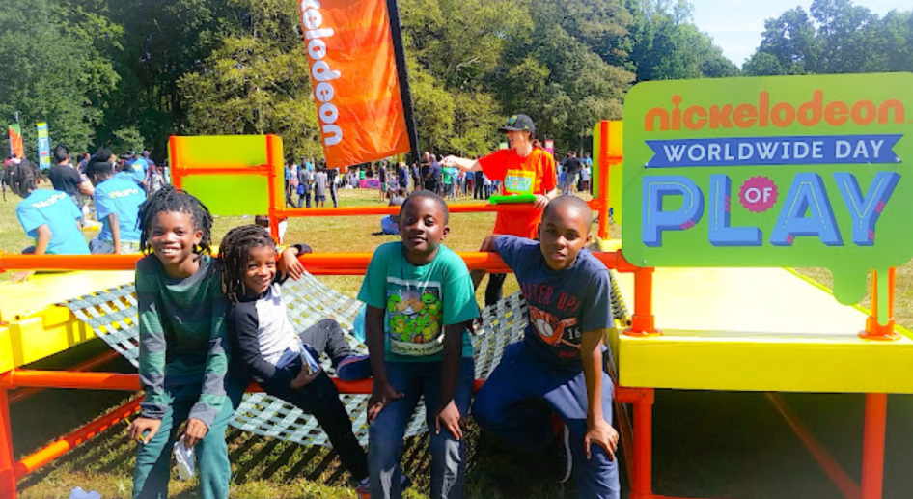
Nickelodeon Worldwide day of Play
Nickelodeon Worldwide day of Play was an annual event organized by the Nickelodeon channel aimed at encouraging parents and children to put down their remotes and go out and play. They show the advantages the people who have been playing outside have managed to realize. By showing this event, parents are allowed to think critically about the various ways they can improve and create healthy relationships with their children. The advert also allows parents to think of ways their children can remain active. Open-mindedness' to these different aspects is among the factors promoted in critical thinking.

Slide 9
References
Cottrell, S. (2017). Critical thinking skills: Effective analysis, argument and reflection. Macmillan International Higher Education.
Monteiro, S., Sherbino, J., Sibbald, M., & Norman, G. (2020). Critical thinking, biases and dual processing: The enduring myth of generalisable skills. Medical education, 54(1), 66-73.
Muniz, M. J. (2018). Hasty Generalization. Bad Arguments: 100 of the Most Important Fallacies in Western Philosophy, 354-356.

